Slide 1

Omega Chess
By: public class teamD

Slide 2
Team Intro public class teamD
Nicholas Cunningham
Sai Donepudi
Dakota Golightly
Victor Mumford

Slide 3
Overview:
Presentation:
User Stories Overview
Class Diagram
Traceability Link Matrix
Kanban Board
Scrum Ceremony Output
Development Manual
Omega Chess Description
Progress Screenshots!

Slide 4
User Stories Overview
User Stories come from P1 and discussions with the Product Owner
We did not add any as there are essential user stories required of us leftover from P1 necessary before meaningful new ones could be added
User Stories
“As a user I would like to be able to:"
(Done in P2) | (Worked on in P2) | (Will do in P3)
- Register an account - Log in to an account | - Create a new match - Invite opponents to it - See the board | - Make a move - Deregister my account - Pause/resume a match - Quit a match - See whose turn it is - See my match statuses - View my all my matches - View my profile - View others' profiles - Win and lose games

Slide 5
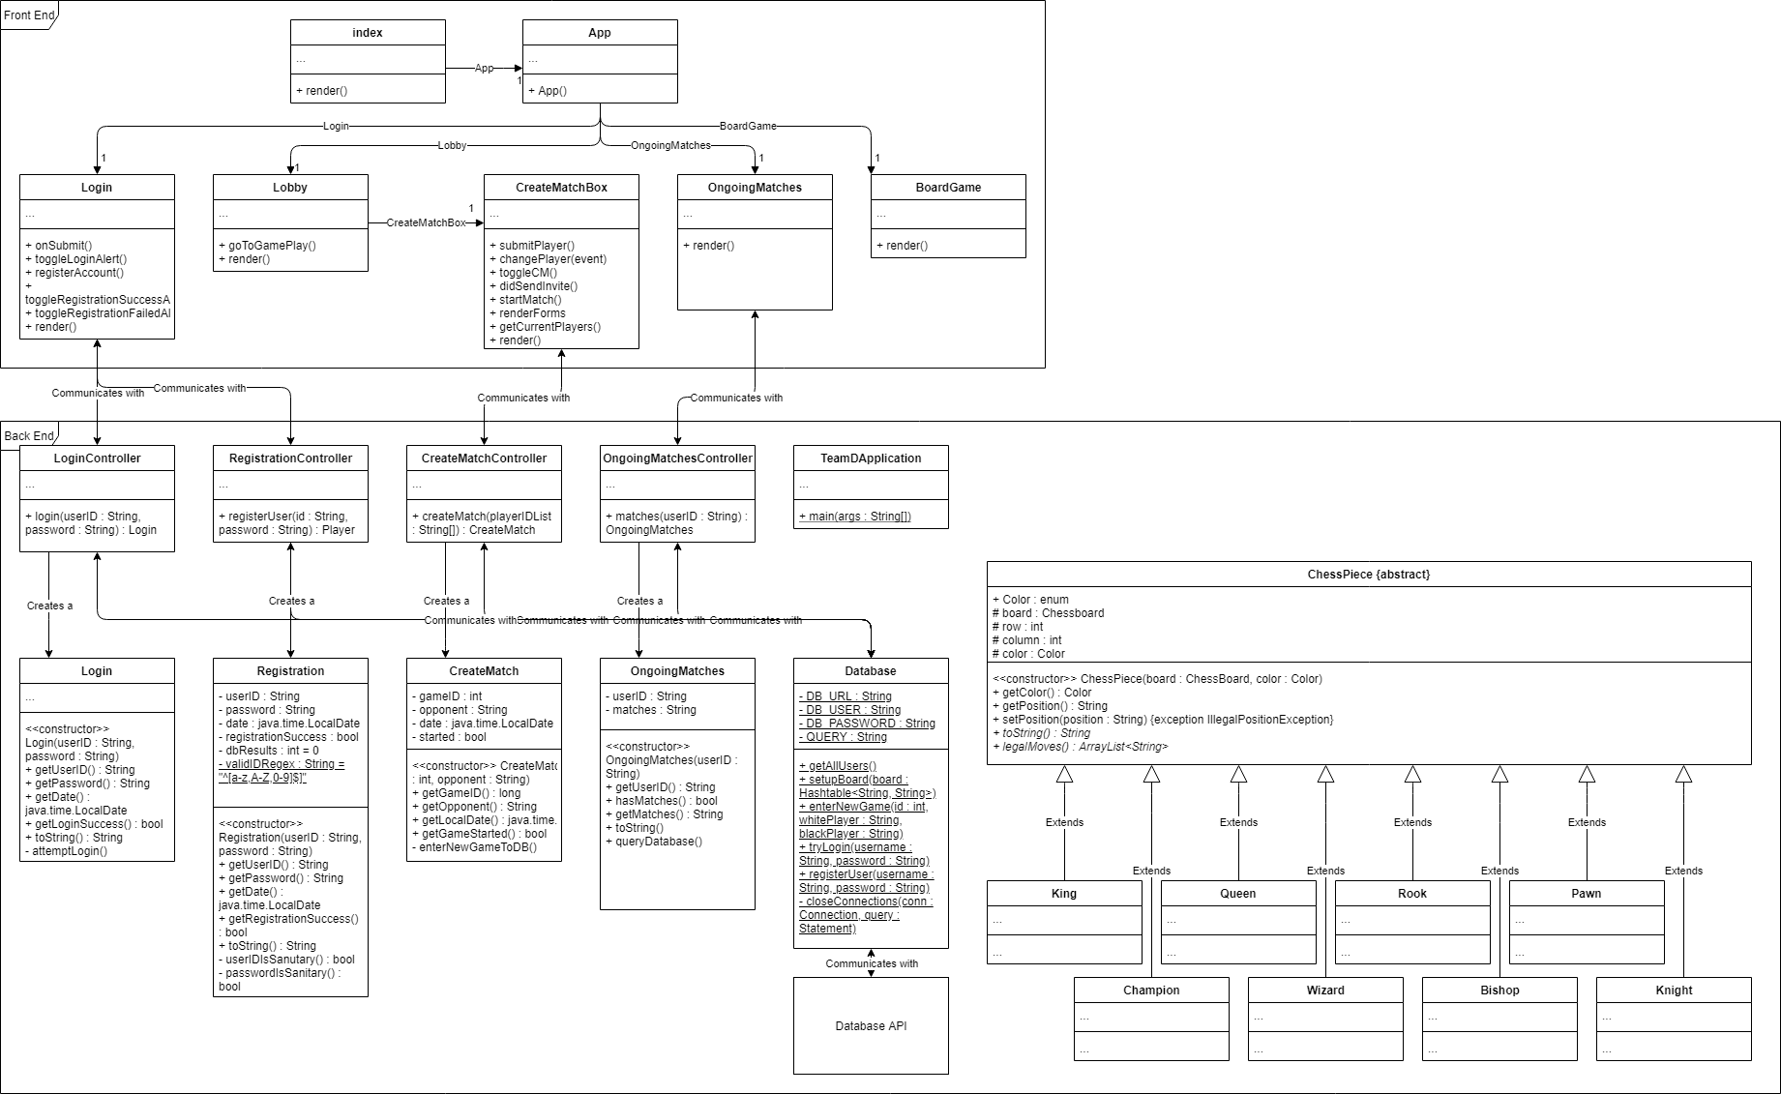
Class Diagram
Visual depiction of class interactions​
Describes the functions of the system and its components

Slide 6
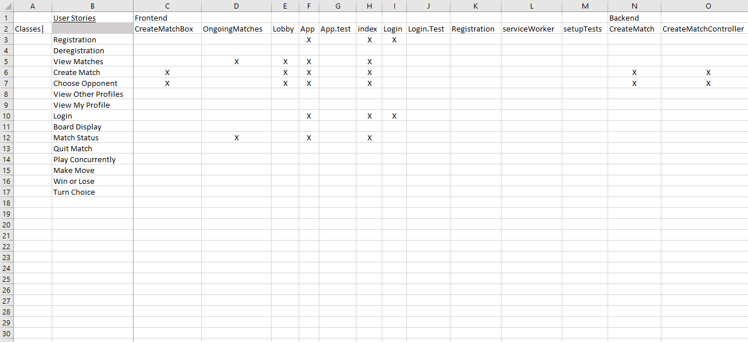
Traceability Link Matrix
Links the classes to their user story origin
Note: The full version is much larger than will fit here, this is only some of it

Slide 7
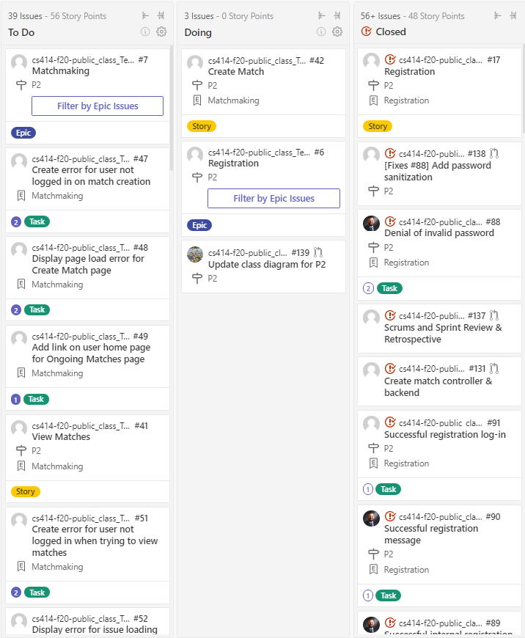
KanBan Board (Zenhub)
Implemented with Zenhub
Shows:
What we have done
What we are doing
What we will do

Slide 8
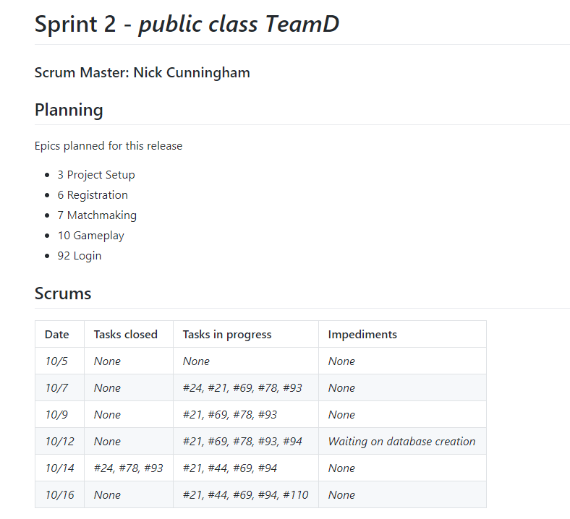
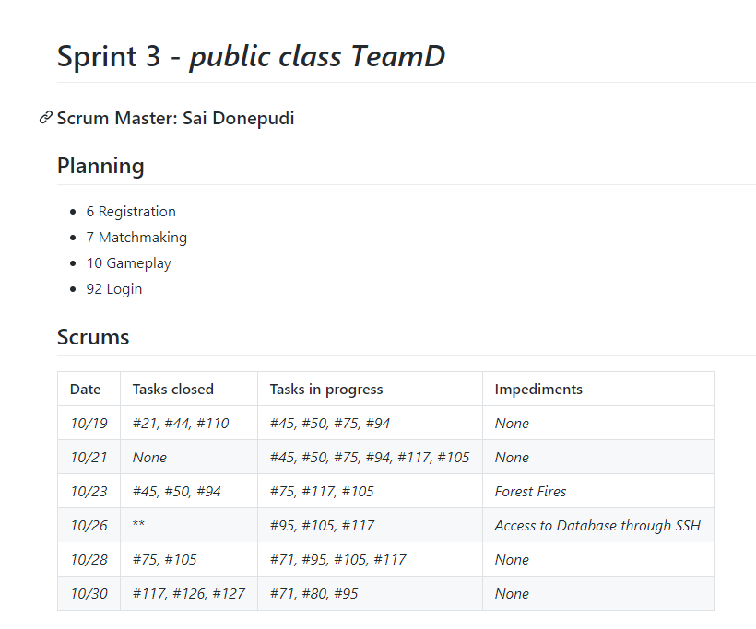
Scrum
Tracked with sprint2.md & sprint3.md document
Two Sprints
Switch of scrum master ½ way through because of real world interruptions
Goals:
Front & Back End communication
Account Registration
Account Login
Retrospective Takeaways:
Our communication improved, and we were able to parallelize our work on different features.
There was a lot of external interference, IBNLT family emergencies and fire evacuation.

Slide 9
Development Manual – How *you* Can Help Too!
(The Short & Sweet Version, the manual is 3-4 pages)
Highlights:
Must be invited to join GitHub repo
IDE-independent development
Front End of:
React Framework
CSS
Some HTML script
Back End of:
Remote database accessible by SSH tunnel
Apache Maven project manager
Spring Boot backend framework
JUnit 5 and Jest for automated testing
Full Development Manual in "/5- Development Manual" of repo

Slide 10
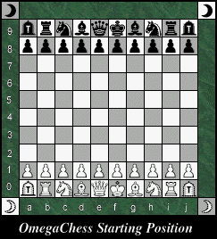
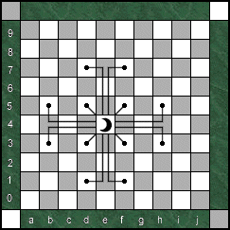
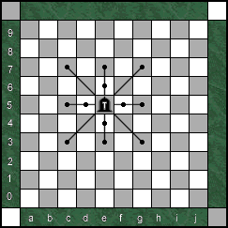
Omega Chess
Looks Like these photos
Chess Ground War (Much Larger)
Extra Pieces
Wizard – ( ¼ Bishop ¾ Knight) Initial Board Setup Champion – (Baby Queen)
Both of these new pieces “leap”
like the knight over pieces
to their destination.

Slide 11
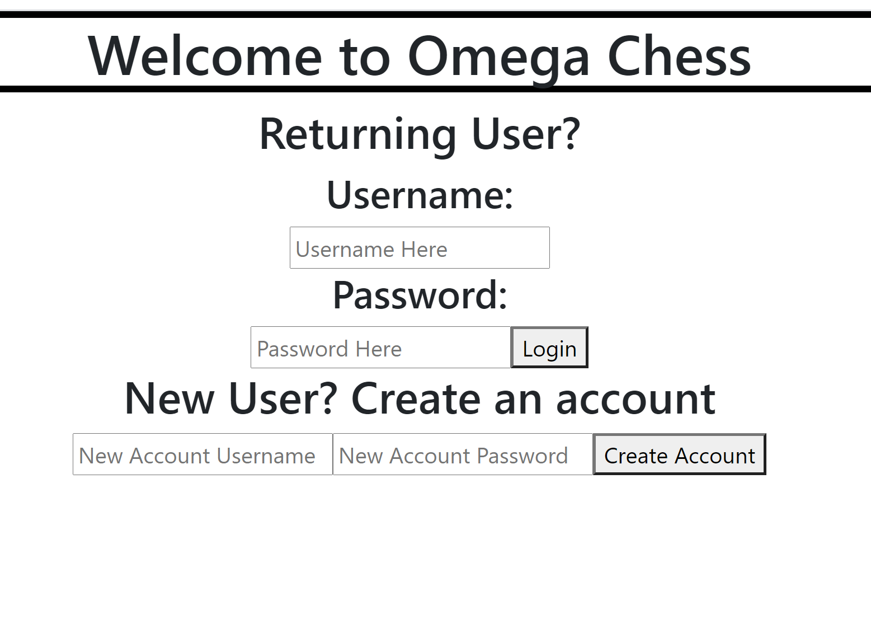
Omega Chess Homepage
From Here:
Returning Player Login
New Player Registration
Decided on Minimalist Design
P2 was for functionality
I.e. front-end to back-end to database connections
P3 is for improvements
I.e. Improve design/UI

Slide 12
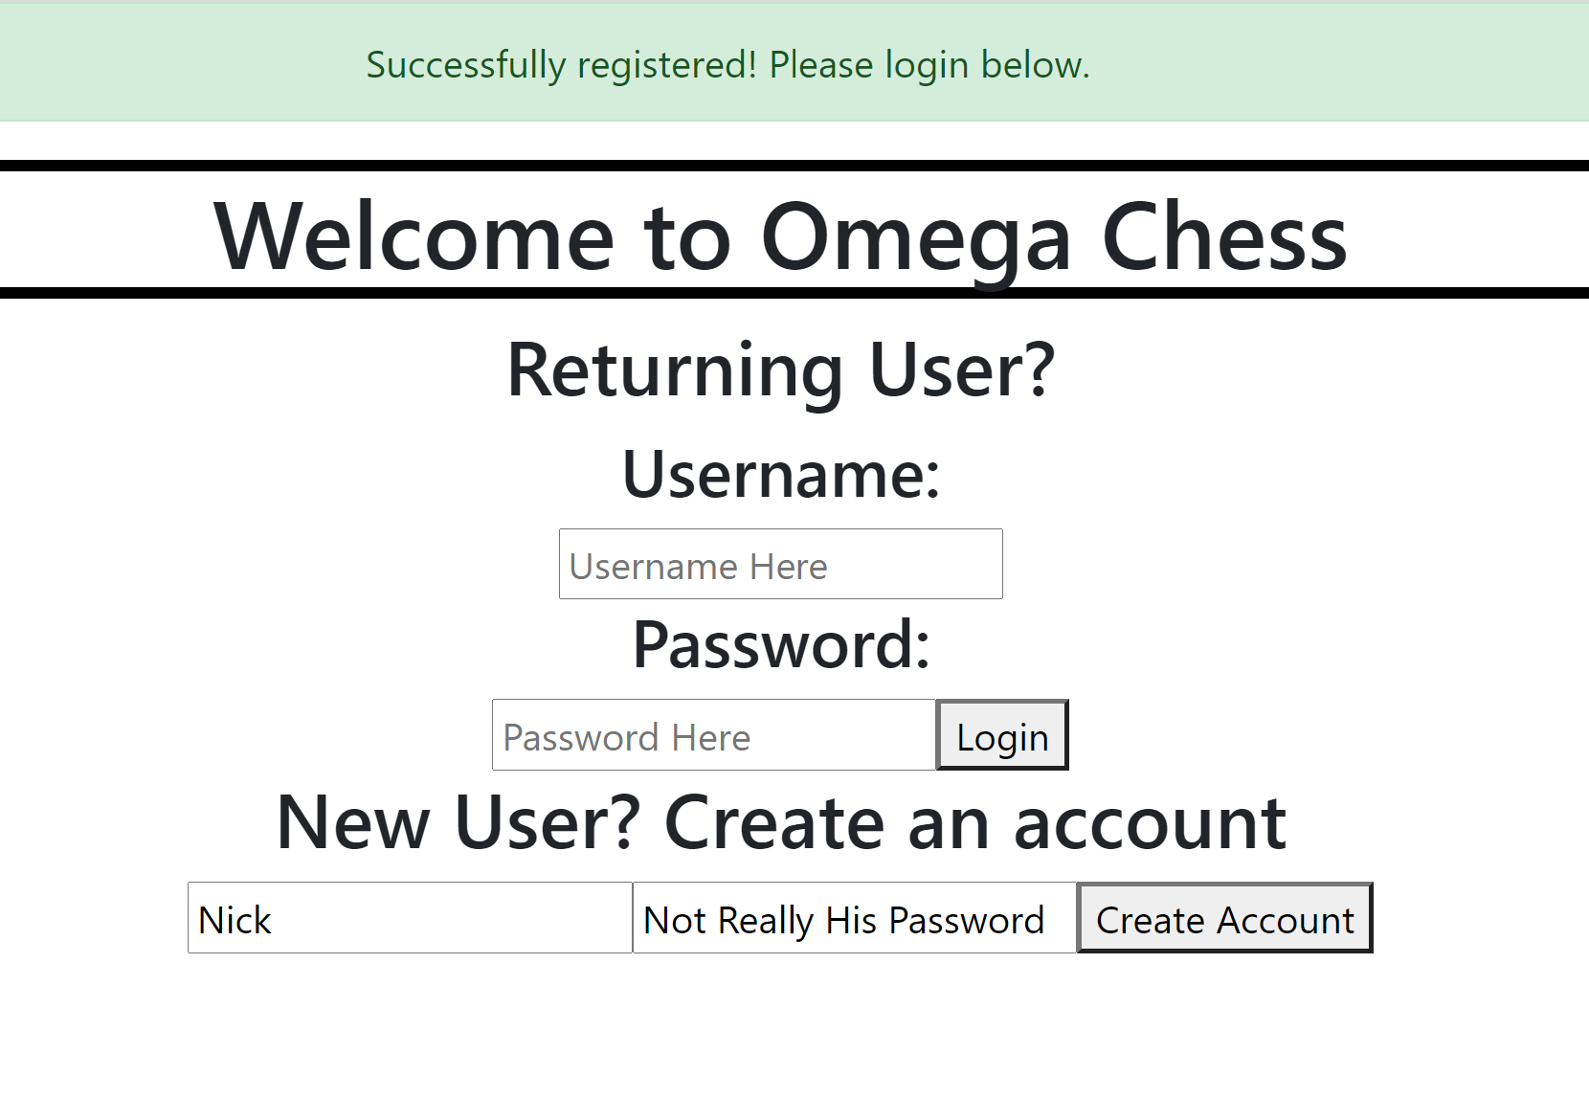
New Account Registration
The right image is after clicking “Create Account”
Registration is done straight from the home page
New accounts are saved to database
Login takes you to the next slide

Slide 13

Returning Player Login
This slide is logging in as Nick from the Homepage
"Beautiful Minimalist Design"
Functional Links to:
New Match Creation
List of Ongoing Matches

Slide 14
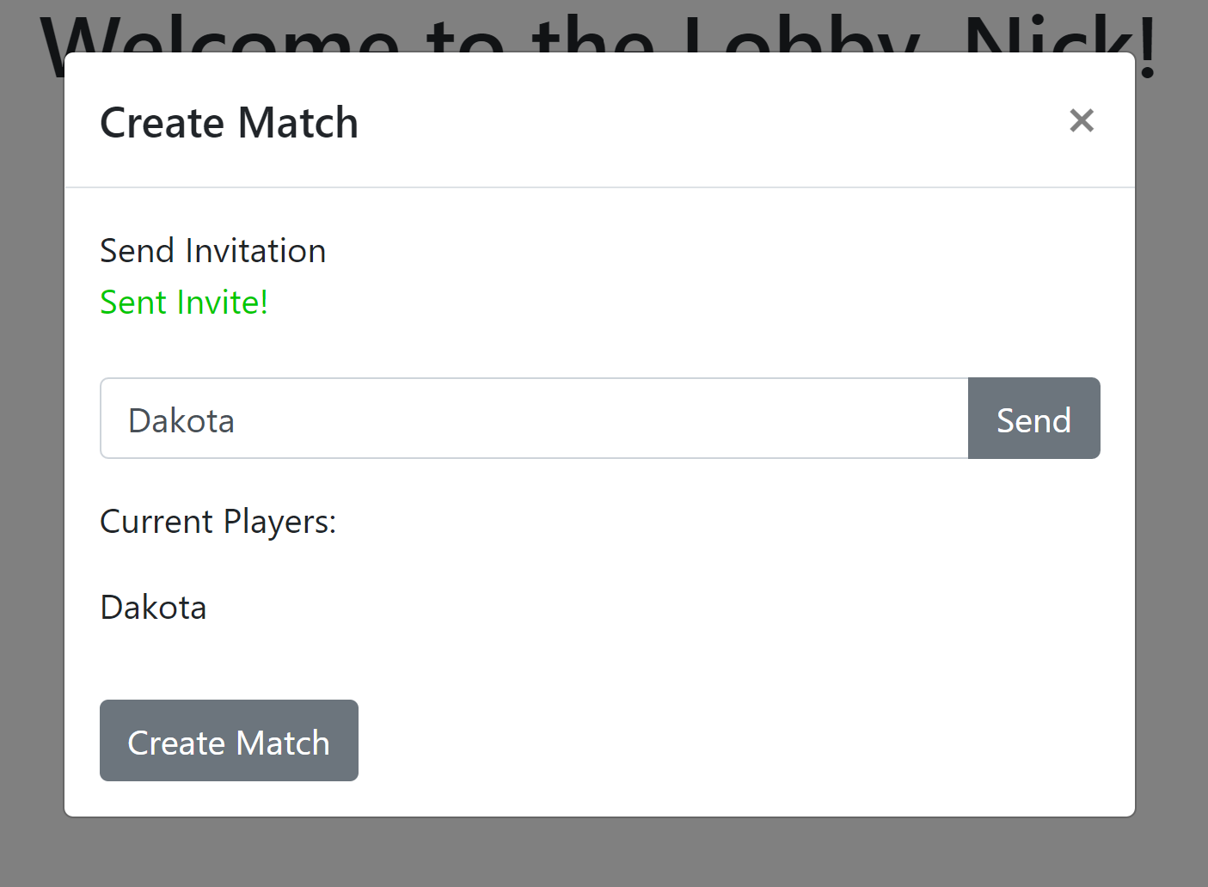
New Match Creation
Slide is directly from Lobby Page & “sending” an invitation
Not Yet Functional
P3 topic

Slide 15
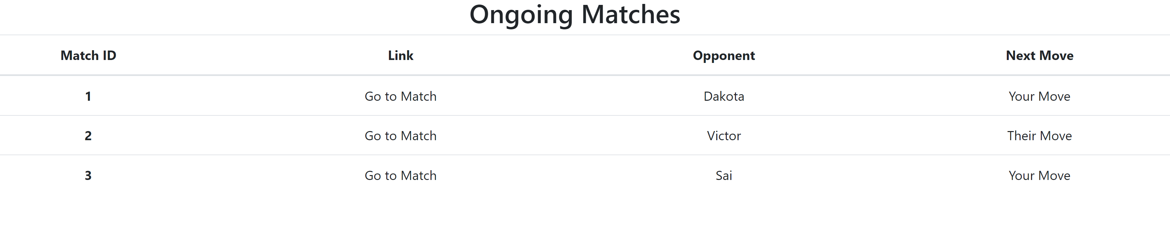
Ongoing Matches List
Displays:
All Matches
Link to match (Implemented in P3)
Opponent (Implemented in P3)
Who has next move (Implemented in P3)
Currently dummy variables, will be done in P3

Slide 16

That’s all folks!
Image is property of Marvel Studios llc.
We claim no rights to this image or its subject material

